Slide 1
An Overview of RTI and Interventions

Slide 2
Agenda
Introduction of Team
Changes 2015-16
Presentation of Tiers
Questions
Notes:
Today’s PD will cover an overview of RTI and all Tiers.

Slide 3
Team Members
Intervention
Behavior Management
Sherley Flores
Valerie Holberton
Terry Manscuk
Maria Petrella
Nicole Winters
Ana Derleth
Shanta Rutland
Jamie Stein
Rebecca Van Alstyne
Meredith Lee
Tabitha Baker
Notes:
This year we will have two teams. Intervention focused on academics and the BMT on behavior.

Slide 4

Parking Lot
Notes:
Please take a moment to write your questions. All questions are important and will be answered. Due to the time, we will answer questions as a team and send out the responses via-email and the weekly post. Please be specific and while walking out place it at the parking lot.

Slide 5
Changes for 2015-16
OLD
NEW
RTI team member will have 2 open times for staff to come for assistance.
Documentation will be handed in 4 times a yr for administration review
Documentation Log
RTI referral process
Grade level Meeting once a month to go over documentation
Documentation will be handed in to RTI team for feedback
Tier 2 Language Arts done by Reading teacher (K-2)

Slide 6
RTI Checklist
PLEASE SUBMIT THIS CHECKLIST AND SUPPORTING DOCUMENTS TO TERRY MANSCUK B
Please complete table below.
Check each box once these documents have been submitted.
Aimsweb Graph
Intervention Log
Assessments | Fall/Winter/Spring | Performance Level
NWEA: ELA
NWEA: Math
Aimsweb: Reading
Aimsweb: Math
DRA
STAR

Slide 7
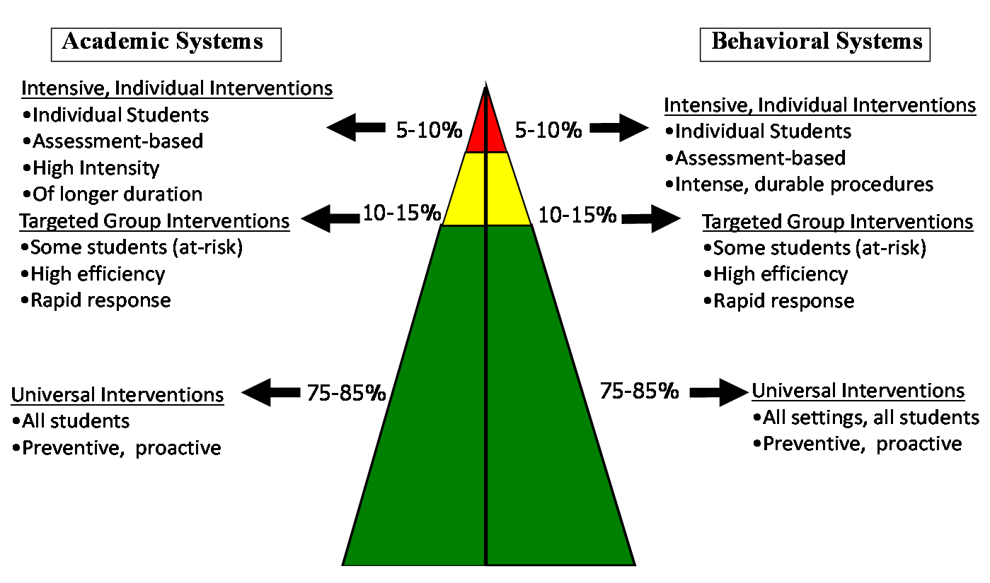
Grade Level Intervention Team Member will work with you in Tier 1 & 2.

Slide 9
Components of an Intervention
Documentation
Progress Monitoring
Evidence

Slide 10
Documentation
Tier ___ Intervention Documentation
Intervention Focus:
Student |  | Year | 2014-2015
ID # |  | Grade
School |  | Teacher
1 mtg. |  | Attendance
2 mtg. |  | Attendance
3 mtg |  | Attendance
ELA |  | MATH |  | BEHAVIOR
Fluency Sight Words Vocabulary Comprehension Listening | Phonemic Awareness Phonics Speaking Writing Genres Writing Mechanics | Number Sense and Operations Problem Solving Algebra Reasoning and Proof Connection | Geometry Measurement Statistics and Probability Vocabulary Presentation | Describe:
Date | Baseline (current level) | Goal | Intervention | Group Size | Frequency | Person Responsible | Attendance In Intervention

Slide 11
Progress Monitoring
Aimsweb with Fidelity
Tier 1- once a month
Tier 2- twice a month
Tier 3- once a week

Slide 12
Evidence
Student work
Benchmarks from Intervention Program
Reports from computer base program
Teacher notes with student work

Slide 13
Tier 1 (Universal)
Components | Academic Examples | Behavior Examples
Documentation | Teacher’s Plans Student Attendance Record | Classroom Behavior Plan Parent Log Student Behavior Log
Progress Monitoring | Pre and post assessments from curriculum Universal Screening (NWEA, Aimsweb) Progress Monitoring (1x per month) Summative Assessments | Student Behavior Log Behavior tally Chart Behavior Scatter Plot
Evidence | Student work samples Pre and post assessments Universal Screening Reports Aimsweb | Student Behavior Log Office Referrals Work not being completed Student work

Slide 14

Are classroom instructional strategies and supports sufficient to help the student achieve academic success?
YES | NO
Keep on doing what your doing ! | Check and collect evidence . Ensure that core instruction has been delivered with fidelity. Does the student have underlying attendance, home, language, or behavioral concerns that may be impacting academics? These concerns need to be addressed before moving forward. If everything checks out, move to Tier 2 for additional supports.

Slide 15
Tier 2 (Strategic)
Components | Academic Examples | Behavior Examples
Documentation | Intervention Documentation | Intervention Documentation
Progress Monitoring | Aimsweb Progress Monitoring (2x per month) at one level above student’s academic level | Student Behavior Log Behavior tally Chart Behavior Scatter Plot
Evidence | Pre and post assessments from Research- Based Program Student work samples from Research-Based Program Reports from Research-Based Program Lessons or Teacher Antidotal notes Aimsweb Data | Student Behavior Log Office Referrals Work not being completed Student work Parent Log

Slide 16
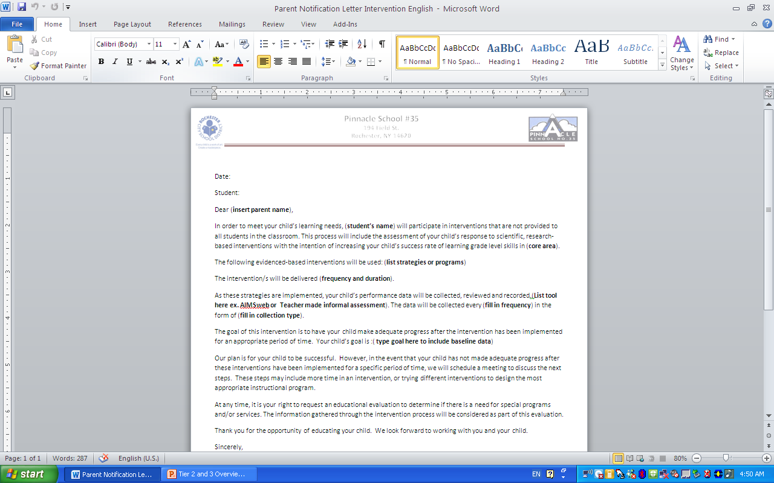

Slide 17
Is the research-based program sufficient to help the student achieve academic success?
YES | NO
Keep on doing what your doing ! | Check and collect evidence . Ensure that research based program has been delivered with fidelity. Does the student have underlying attendance, home, language, or behavioral concerns that may be impacting academics? These concerns need to be addressed before moving forward. Attempt another Research-based program for another 4 weeks. If everything checks out, fill out RTI referral and submit to Mrs. Manscuk to Tier 3 for additional supports.

Slide 18
What do you need to do for Tier 3?
Fill out Intervention Referral
Continue Tier 1 progress monitoring at grade level once a month
N. Winters will progress monitor once a week
Attend once a month meeting with RTI team to review data and documentation
Ask questions and be diligent about the case. You have worked hard to get student to Tier 3!!!

Slide 19
Tier 3 with Ms. Winters
Only accept students that have Tier 2 and have come to the RTI team
Only monitor once a week at student’s working level.
Classroom teacher continues to monitor at grade level once a month.
They can not make-up work that is missed. We need to be creative with missed work.

Slide 20
Thank you for coming. Please take a moment to fill out the survey.

